Slide 1
Research Computing Update
November 2020

Slide 2
HPC Resources
New HPC Procurement via ANKABUT
PO has been issued, and awaiting delivery of hardware.
Expect deliver second to third week of December
HPC service planned to be up and running by early 2021
SAN HPC Cluster
SAN HPC cluster to be decommissioned by end of January 2021
Currently planning migration of data

Slide 3
Resource Utilization

Slide 4
KU Cluster core distribution

Slide 5
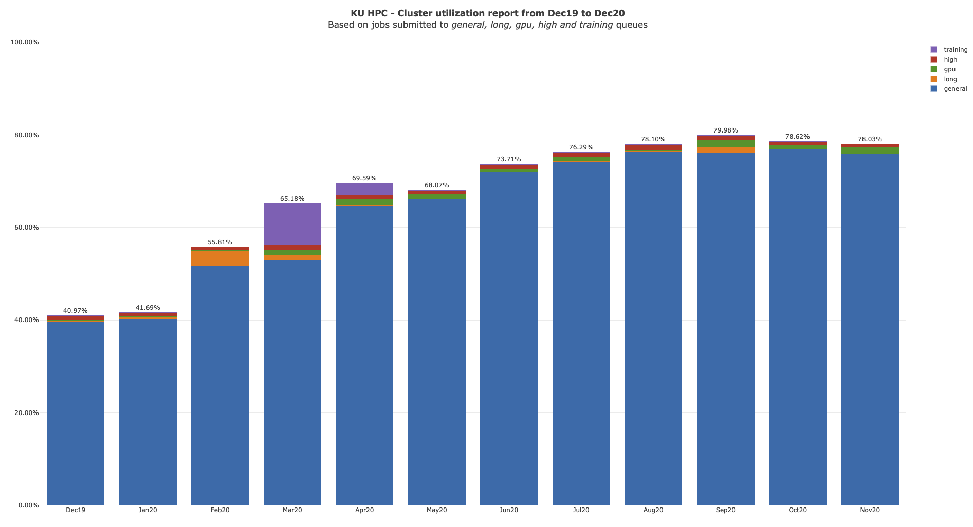

Slide 6
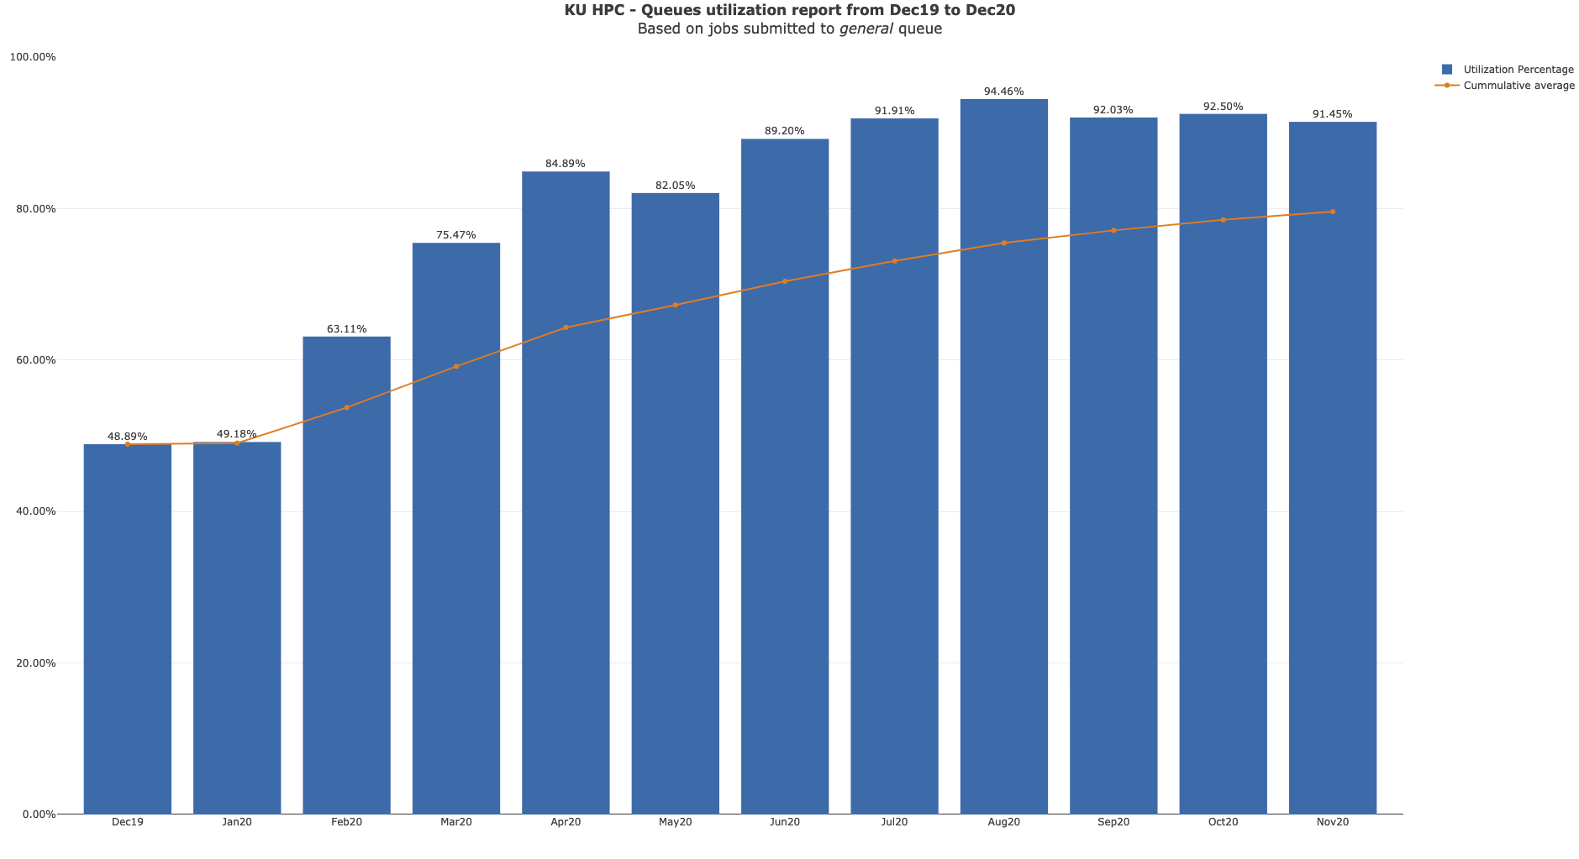

Slide 7
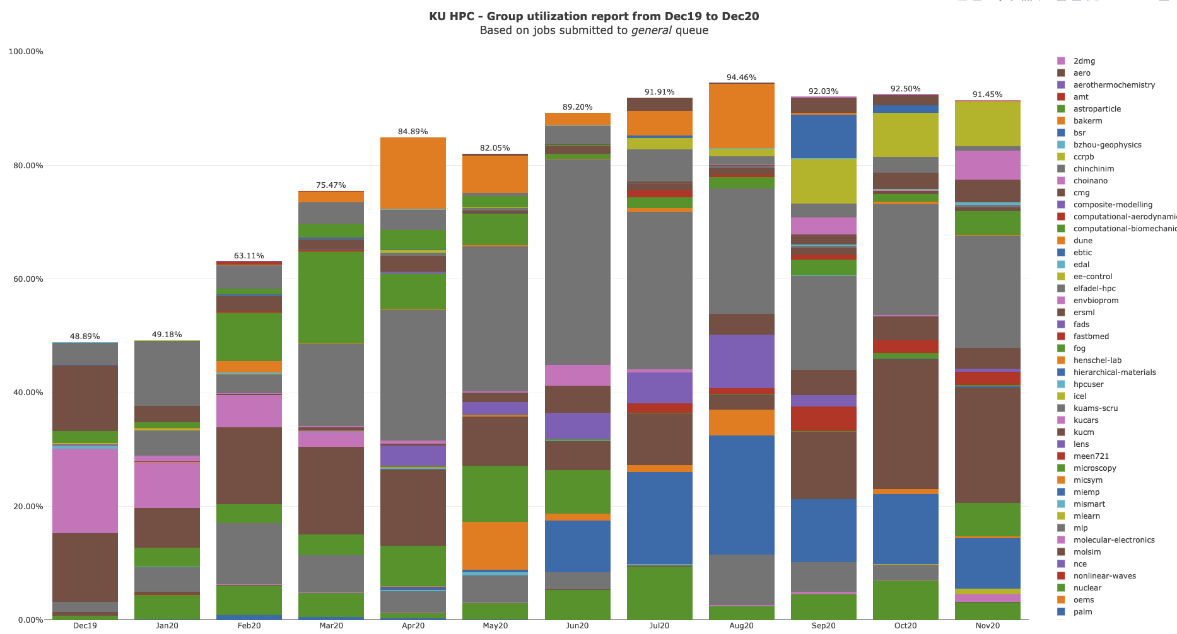

Slide 8
KU HPC Group Utilization for October 2020.
Note that do not yet keep track of applications used automatically. This is a work in progress, and will be added to future reports.

Slide 9
PI Cluster core distribution

Slide 10
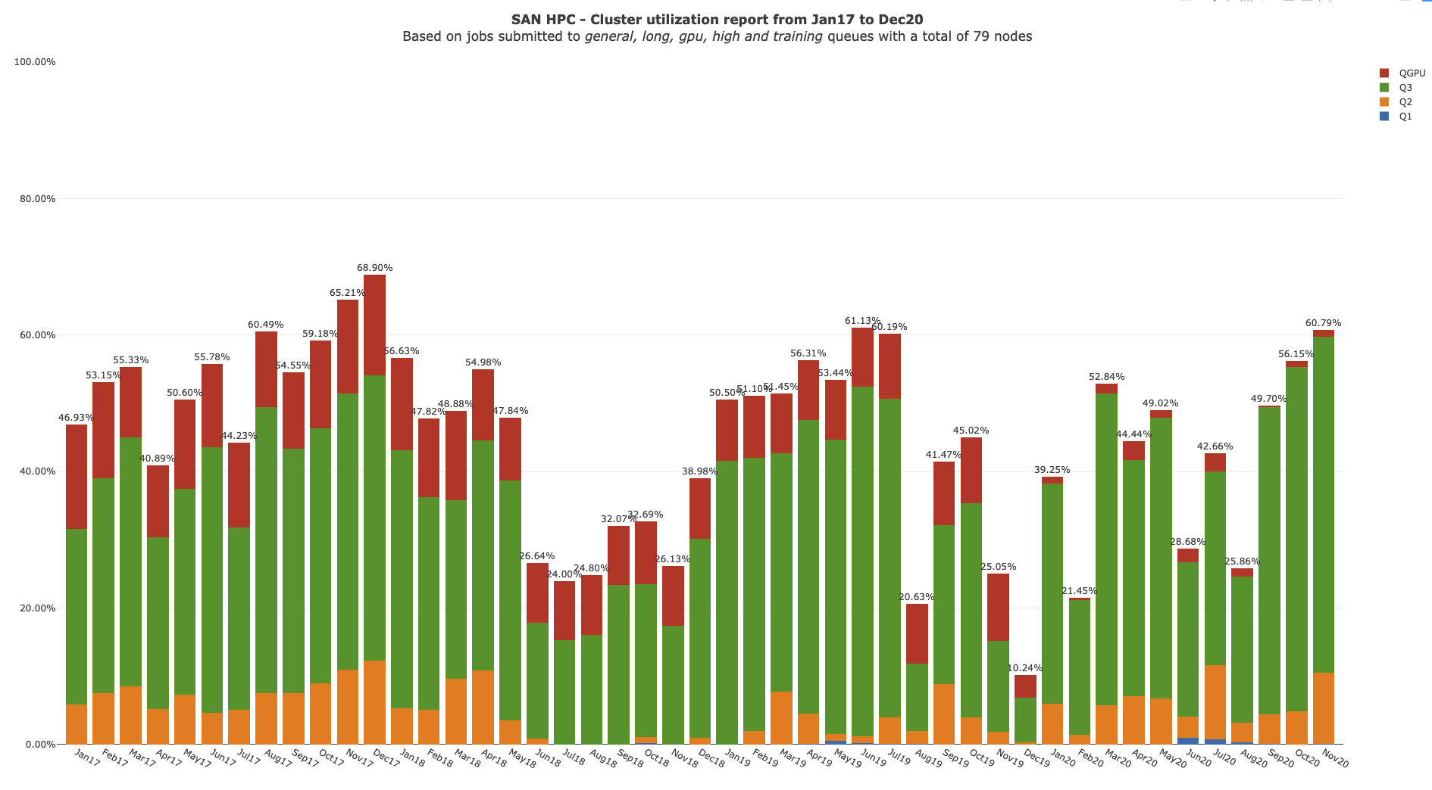

Slide 11
Status of KPI’s

